Slide 1
Przysłowia i powiedzenia Angielsko-Polskie

Slide 2
Practice makes perfect. Praktyka czyni mistrza My mom says ,,Practice makes perfect".

Slide 3
Chill, relax, unwind. Wyluzuj, zrelaksuj się, odpocznij. Chill, relax, unwind on this vacation.

Slide 4
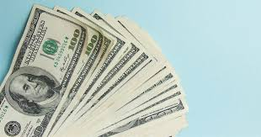
Envy never enriched any man.
Zazdrość nikogo jeszcze nie wzbogaciła.
Envy never enriched any man so I never envy others.

Slide 5
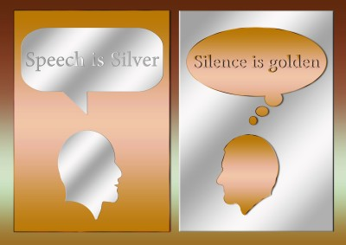
Speech is silver, silence is golden.
Mowa jest srebrem, milczenie złotem.
Think before you say something.

Slide 6
Easier said than done.
Łatwiej powiedzieć, niż zrobić.
Easier said than done because actions are more difficult.

Slide 7
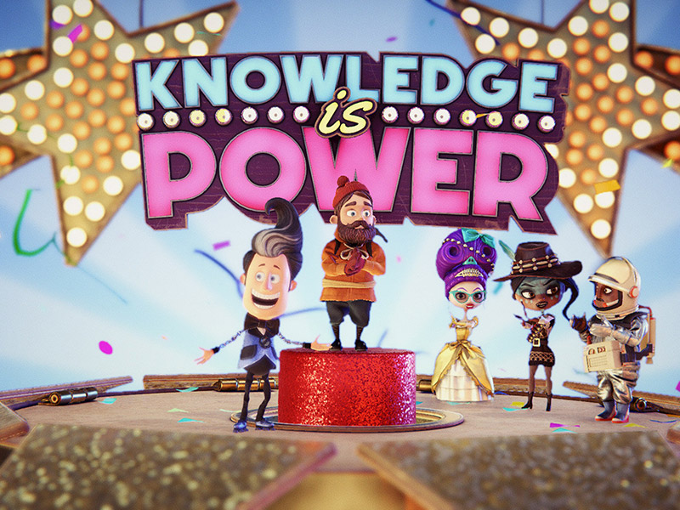
Knowledge is power.
Wiedza to potęga. At the University, they told me knowledge is power.

Slide 8
A change is as good as a rest.
Odrobina odmiany dobrze robi.
A bit of variety does well in some cases.

Slide 9
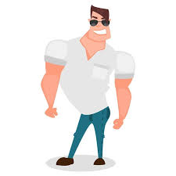
Every man has his faults.
Nie ma ludzi bez wad.
I found out for myself that every man has his faults.

Slide 10
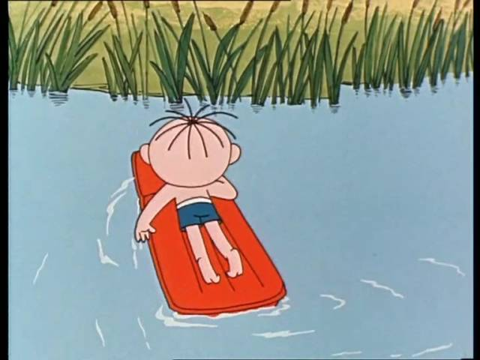
Let’s have marvelous adventures together.
Przeżyjmy razem cudowne przygody.
Let's experience great adventures at the lake together.

Slide 11
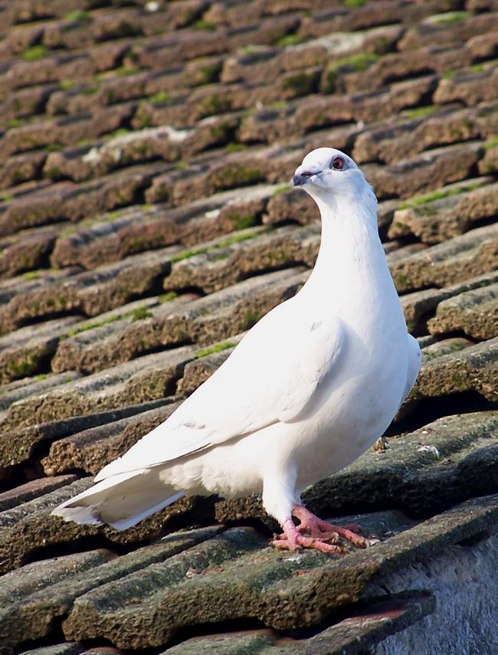
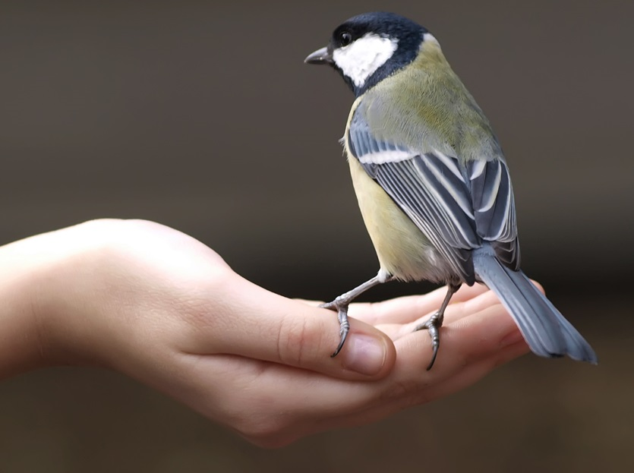
A bird in the hand is worth two in the bush.
Lepszy wróbel w garści niż gołąb na dachu. A bird in the hand is worth two in the bush someone once said .

Slide 12
Paulina Moniuszko dziękuję za uwagę

